Slide 1
CSS
Cascading Style Sheets for styling HTML

Slide 2
Syntax
selector {
property: value
}

Slide 3
Usage
Embedded view
Inline styles
External files

Slide 4
Embedded styles
<!DOCTYPE html>
<html lang="en">
<head>
<meta charset="utf-8" />
<title>My App</title>
<base href="/" />
<meta name="viewport" content="width=device-width, initial-scale=1" />
<style>
body {
width: 100%
}
</style>
</head>
<body>
</body>
</html>

Slide 5
Inline styles
<div style=“width: 100%”></div>

Slide 6
External file
Index.css
Body {
width: 100%
}
Index.html
<!DOCTYPE html>
<html lang="en">
<head>
<meta charset="utf-8" />
<title>My App</title>
<base href="/" />
<meta name="viewport" content="width=device-width, initial-scale=1" />
<link rel="stylesheet" href=”index.css">
</head>
<body>
</body>
</html>

Slide 7
Selector types:
Tag selector - Body { width: 100% }
Class selector - .item { width: 100% }
Id selector - #unique-id { width: 100% }
Context selector / Descendant Selector - .div p { color: red; }
Child selector - .parent > p { color: red; }
Adjacent Sibling Combinator - .sibling-a + sibling-b { color: red }
Pseudo-Classes - a:hover { color: blue }

Slide 8
Inheritance
Inheritance in CSS is the mechanism by which some CSS properties applied to a parent element are automatically passed down to its child elements.

Slide 9
Inheritance example
<!DOCTYPE html>
<html>
<head>
<style>
body {
color: darkblue; /* This will be inherited */
font-family: Arial; /* This too */
}
</style>
</head>
<body>
<div>
<p>This paragraph inherits the text color and font from the body.</p>
</div>
</body>
</html>

Slide 10
Inherited properties:
color
font
font-family
font-size
font-style
font-variant
font-weight
letter-spacing
line-height
quotes
text-align
text-indent
text-transform
visibility
white-space
word-spacing

Slide 11
Non inherited properties
margin
padding
width
height
border
background-color
display
position
top
left
right
bottom
z-index
overflow
flex
justify-content
align-items
box-shadow
opacity
transform

Slide 12
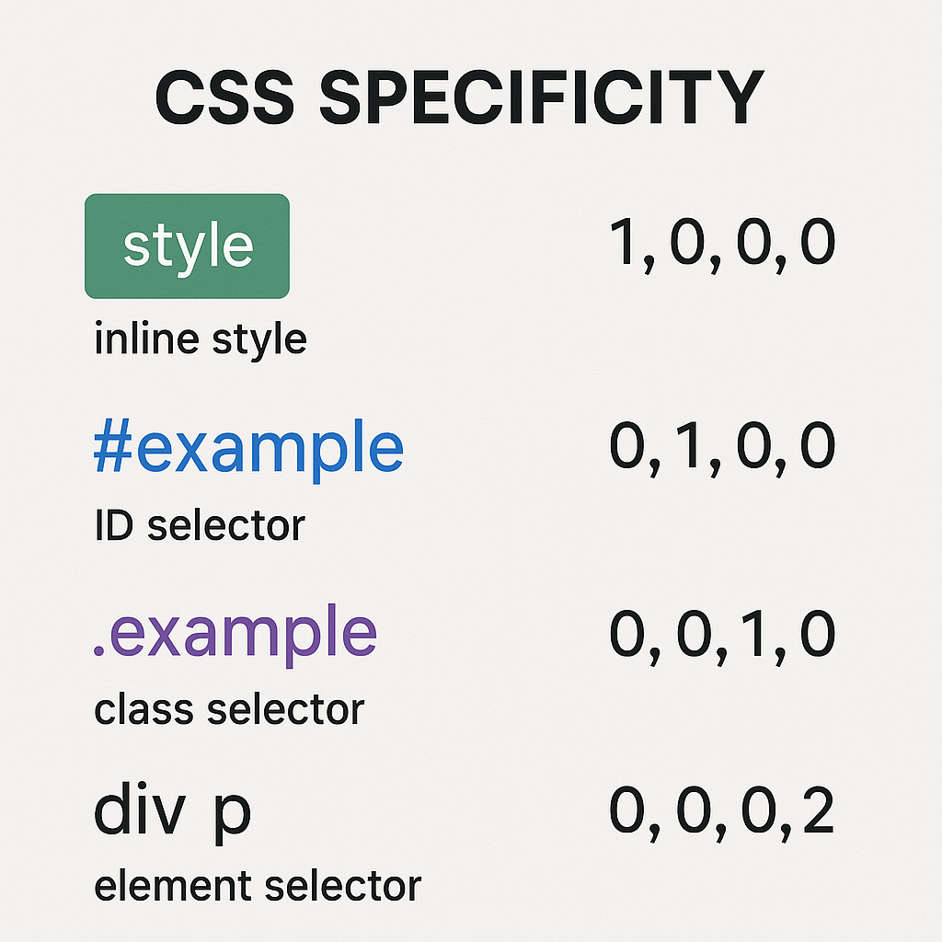
CSS Specificity: How Styles Are Applied
Importance
Specificity
Order

Slide 13
DOM
Document Object Model

Slide 14
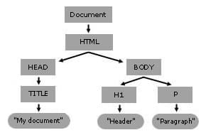
DOM – Document Object Model

Slide 15
Document element types:
block elements – breaks line before and after elements. Fill all available width possible to set width height marign an
inline elements – Doesn’t break line before and after elements. Width and height is set by content

Slide 16
Examples
Block elements – div, ul (other list elements too), p
Inline elements – a, span, strong, img

Slide 17
Element types
display: block;
display: inline;
display: inline-block;
display: none;

Slide 18
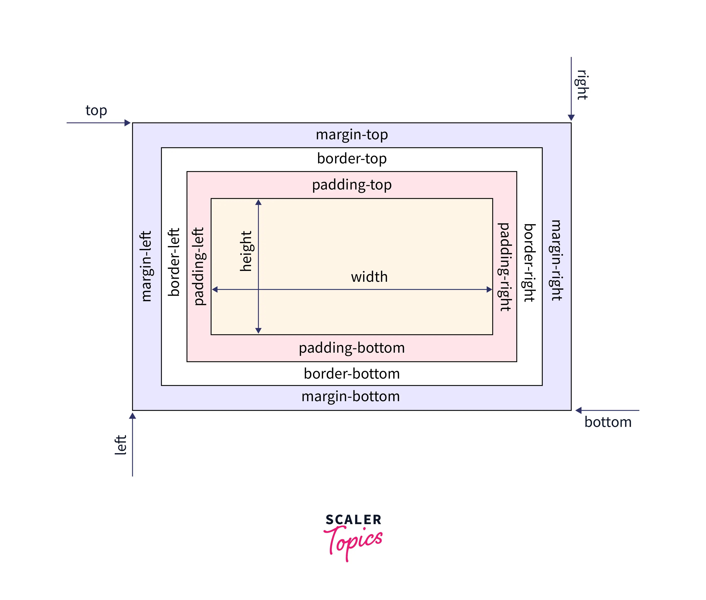
Box Model
Box sizing: border-box vs content-box

Slide 19
Element spacings:
Margin: 1px 1px 1px 1px
Margin: 1px 1px 1px
Margin: 1px 1px
Margin: 1px
Padding: 1px 1px 1px 1px
Padding: 1px 1px 1px
Padding: 1px 1px
Padding: 1px
Border: 1px solid red

